Slide 1

App Testing, Deployment & Maintenance

Slide 2
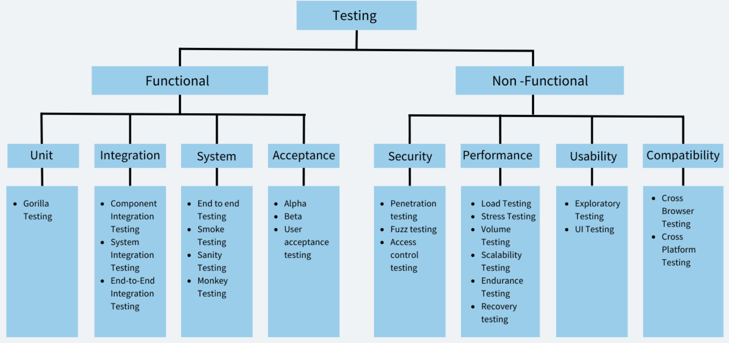
Types of Testing
Testing is a critical part of the app development lifecycle. It ensures that the app is functional, user- friendly, and performs well under various conditions.

Slide 3
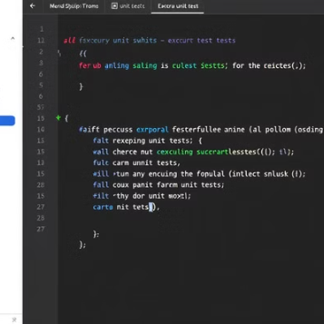
Unit Testing
Unit tests isolate and validate individual components. Each unit of code works as expected. This reduces bugs. Early detection helps maintain app stability.
Tests individual components or functions in isolation.
Ensures that each part of the app works as expected.
Example: Testing a function that calculates prime number.

Slide 4
Unit Testing
Check Prime Number
Function:
bool isPrime(int number)
{ if (number <= 1) return false;
for (int i = 2; i < number; i++)
{ if (number % i == 0) return false;}
return true;
}
Unit Test:
void main() {
test('Prime number test', () {
expect(isPrime(2), true);
expect(isPrime(4), false);
expect(isPrime(11), true);
expect(isPrime(1), false); }); }

Slide 5
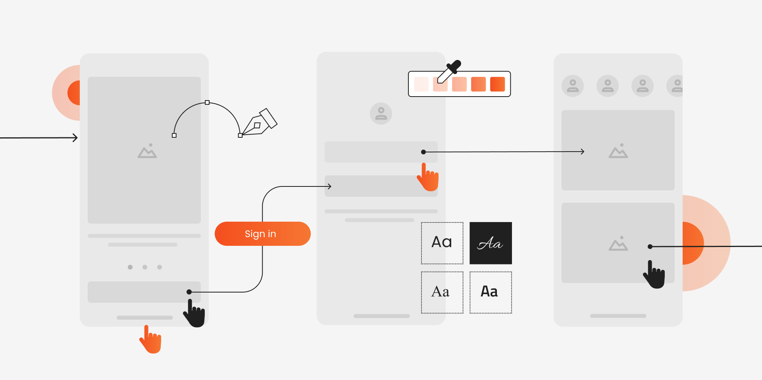
UI Testing
Tests the user interface to ensure it behaves as expected.
Validates user interactions like button clicks, form submissions, and navigation.
Example: Testing if a login button navigates to the home screen.

Slide 6
In a Flutter login screen, you want to verify that pressing the Login button navigates to the Home Screen.
testWidgets('Login button navigates to home', (WidgetTester tester) async {
await tester.pumpWidget(MyApp());
// Find the login button and tap it
final loginButton = find.text('Login');
await tester.tap(loginButton);
await tester.pumpAndSettle();
// Verify if home screen is displayed
expect(find.text('Home Screen'), findsOneWidget);
});
This ensures the login button works correctly.

Slide 7
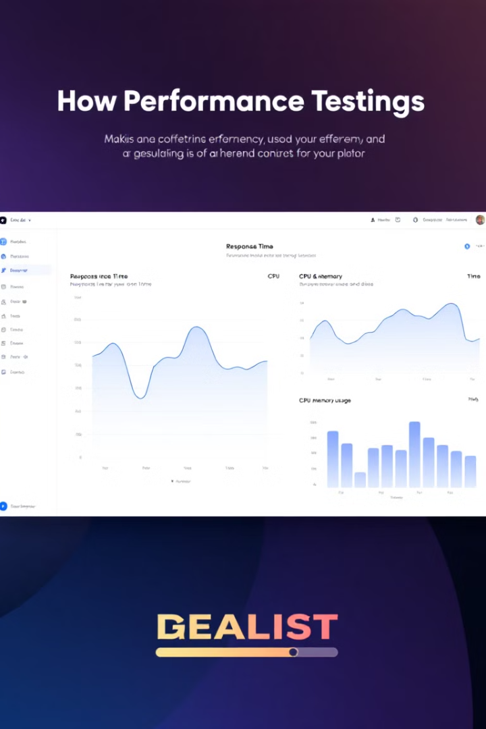
Performance Testing
Evaluates the app’s performance under different conditions (e.g., low memory, high CPU usage).
Ensures the app is responsive and stable.
Example: Testing how the app performs with 1,000 simultaneous users.
To check how your app performs when handling 1,000 simultaneous API requests. Using JMeter or Firebase Performance Monitoring, you simulate heavy loads and analyze response times.
If an API takes more than 2 seconds, it may need optimization.
If the app crashes under heavy load, it indicates a memory leak or inefficiency.

Slide 8

Debugging Strategies and Tools
Debugging is the process of identifying and fixing issues in the app. Effective debugging strategies and tools are essential for maintaining app quality.
Debugging Strategies
Reproduce the Issue: Identify the steps to reproduce the bug.
Isolate the Problem: Narrow down the source of the issue (e.g., specific function or component).
Fix and Verify: Apply the fix and test to ensure the issue is resolved.

Slide 9
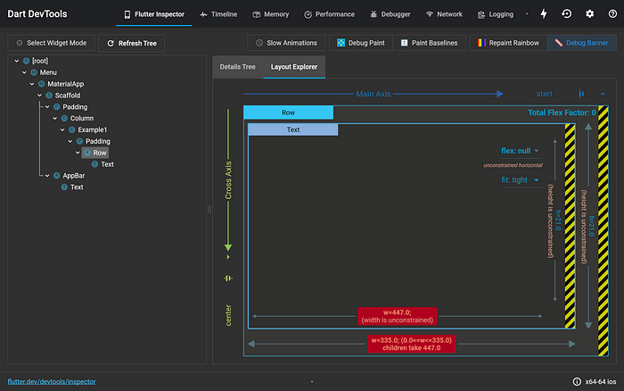
Debugging Tools
Logcat (Android): A command-line tool for viewing system logs and debugging Android apps.
Xcode Debugger (iOS): A powerful debugger for iOS apps, integrated into Xcode.
Flutter DevTools: A suite of debugging tools for Flutter apps, including performance profiling and widget inspection.
How to debug layout issues with the Flutter Inspector | by Katie Lee | Flutter | Medium

Slide 10
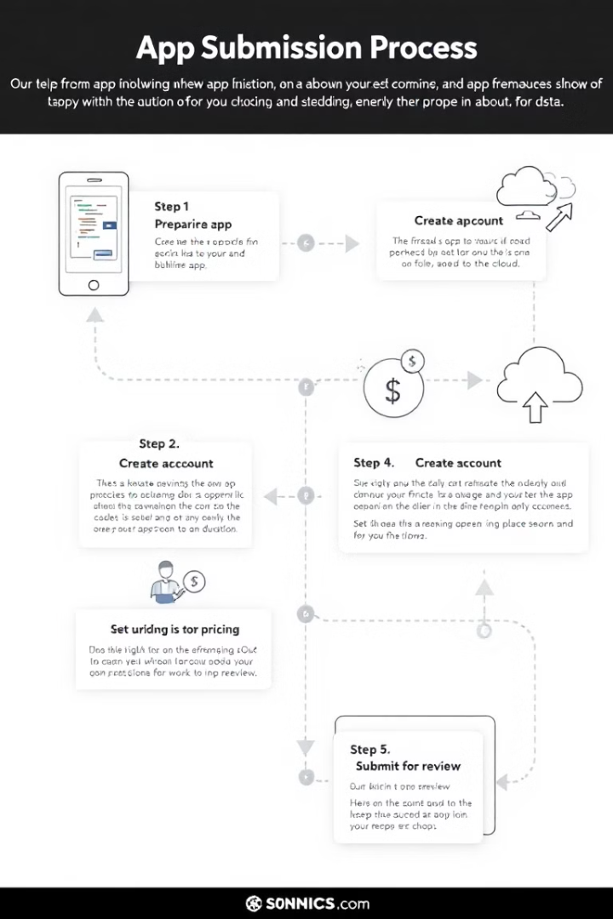
App Submission Process
Submitting an app to the Google Play Store or Apple App Store involves several steps to ensure compliance with their guidelines.
Google Play Store Submission
Prepare the App:
Test the app thoroughly.
Create a signed APK or App Bundle.
Create a Developer Account:
Register as a Google Play Developer (one-time fee of $25).
Upload the App:
Provide app details (name, description, screenshots, etc.).
Upload the APK or App Bundle.
Set Pricing and Distribution:
Choose between free or paid.
Select target countries.
Submit for Review:
Google reviews the app for compliance with their policies

Slide 11
App Submission Process
Submitting an app to the Google Play Store or Apple App Store involves several steps to ensure compliance with their guidelines.
Apple App Store Submission
Prepare the App:
Test the app on real devices.
Create an archive using Xcode.
Create a Developer Account:
Enroll in the Apple Developer Program (annual fee of $99).
Upload the App:
Use Xcode or App Store Connect to upload the app.
Provide app details (name, description, screenshots, etc.).
Set Pricing and Availability:
Choose pricing tiers.
Select target regions.
Submit for Review:
Apple reviews the app for compliance with their guidelines.

Slide 12

App Store Guidelines
Google Play Store Guidelines
• Ensure the app is free of malware and adheres to content policies.
• Provide accurate metadata (e.g., app name, description, screenshots).
• Test the app on different devices and Android versions.
Apple App Store Guidelines
• Follow Apple’s Human Interface Guidelines (HIG).
• Ensure the app is stable and free of crashes.
• Provide clear and accurate app metadata.

Slide 13
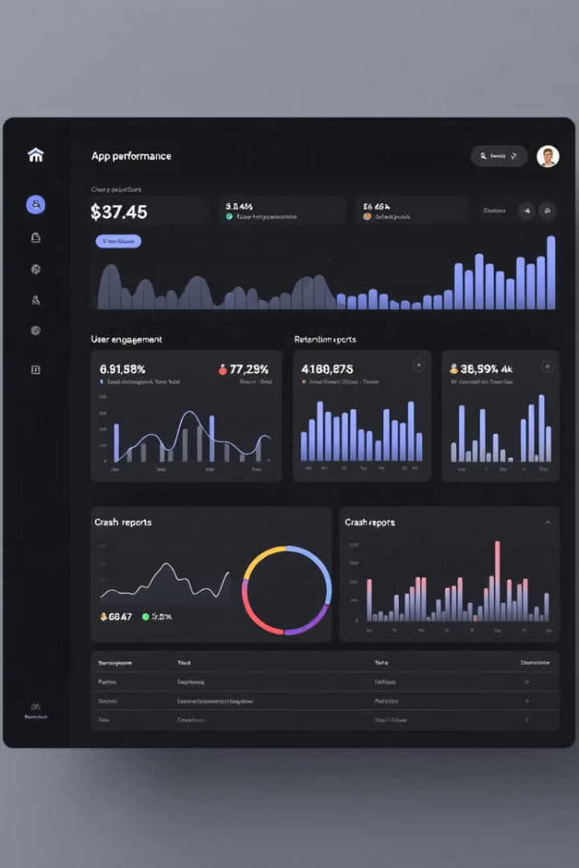
Monitoring and Analytics Tools
After deployment, monitoring and analytics tools help track app performance, user behavior, and issues.
Monitoring Tools
Firebase Performance Monitoring: Tracks app performance metrics like startup time and network requests.
Crashlytics: Reports and analyzes app crashes in real-time.
Analytics Tools
Google Analytics for Firebase: Tracks user engagement, retention, and in-app behavior.
Mixpanel: Provides advanced analytics for user segmentation and funnel analysis.

Slide 14
Conclusion
Testing, deployment, and maintenance are critical phases in the app development lifecycle. By following
best practices and using the right tools, developers can ensure their apps are high-quality, compliant
with store guidelines, and provide a great user experience.

